Slide 1
The cement industry driven by David Brown

Slide 2


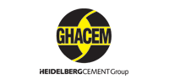












Global Market References in Cement

Slide 3
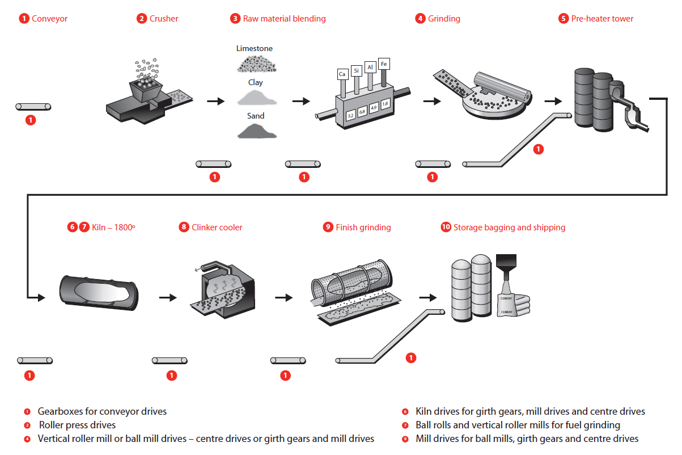
Our Products in Cement Manufacture

Slide 4
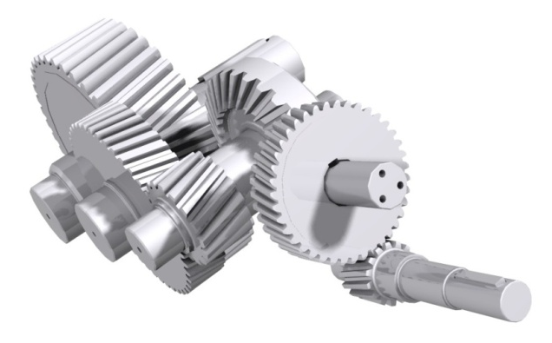
Services Offered
Project studies by our project department
Rapid solution proposals
Validation of specifications
Manufacture
Complete Project management
Assistance during installation and commissioning
Aftermarket support during the long life of the gearbox
Specific solutions according to your specifications

Slide 5
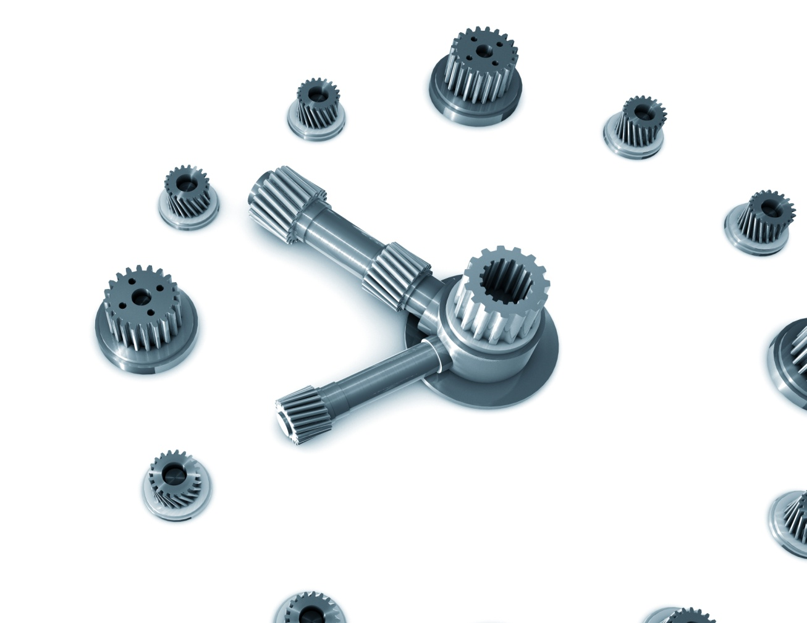
Gearboxes throughout their Life Cycle
6- Assistance with installation and commissioning
5 – Optimisation of your equipment
7 – Parts Replacement
In situ or in our works
4- Repair and Maintenance
3- Manufacture in our own workshop and with our supply chain patners
2- Specific Solutions according to your requirements
1- Analysis of project. and Diagnostics

Slide 6
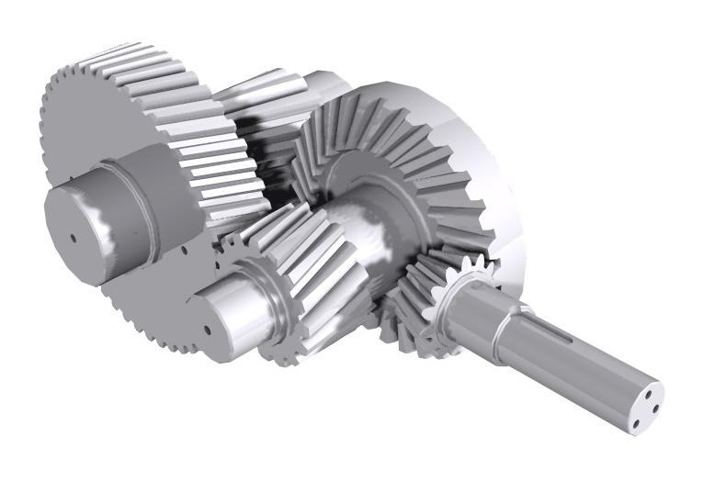
Management of your Existing Equipement
Expertise on site
Diagnostic testing in the workshop
Repair and refurbishment
Reconditioning
Improving reliability of equipment
Audit and plan maintenance
Turnkey Service
Responsibility and Reactivity
Workshop technicians throughout the world with the
support of our global technical rsources. Global
support delivered locally.
All types and all makes, not just David Brown

Slide 7
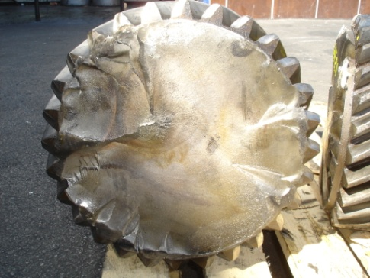
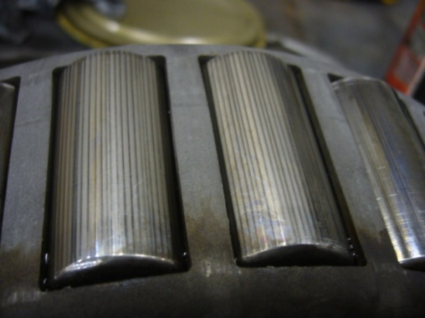
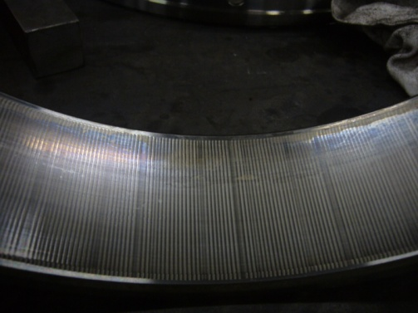
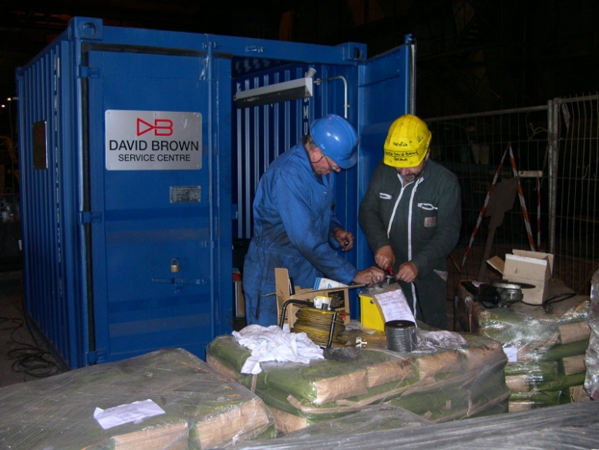
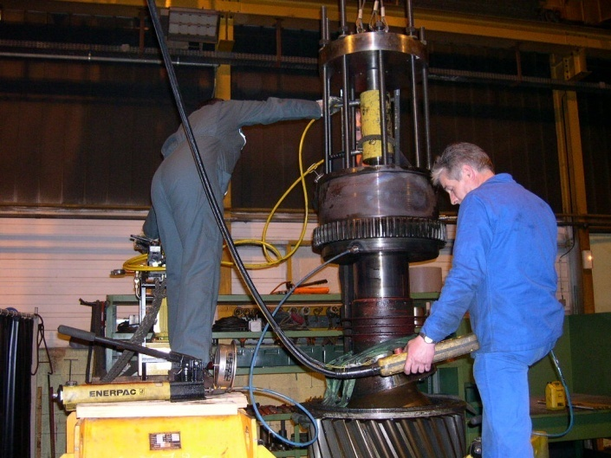
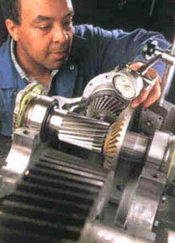
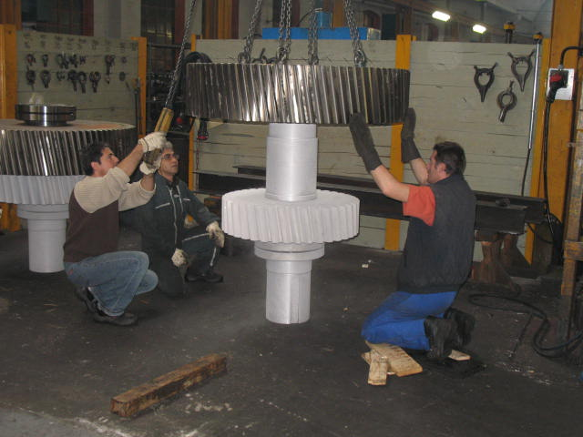
Aftermarket Support
EXPERTISE, SERVICE & REPAIR IN HOUSE OR IN SITU

Slide 8
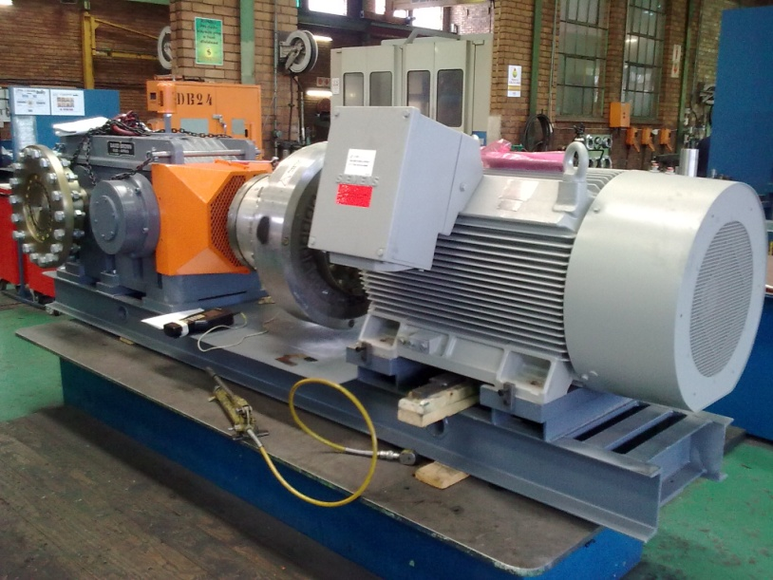
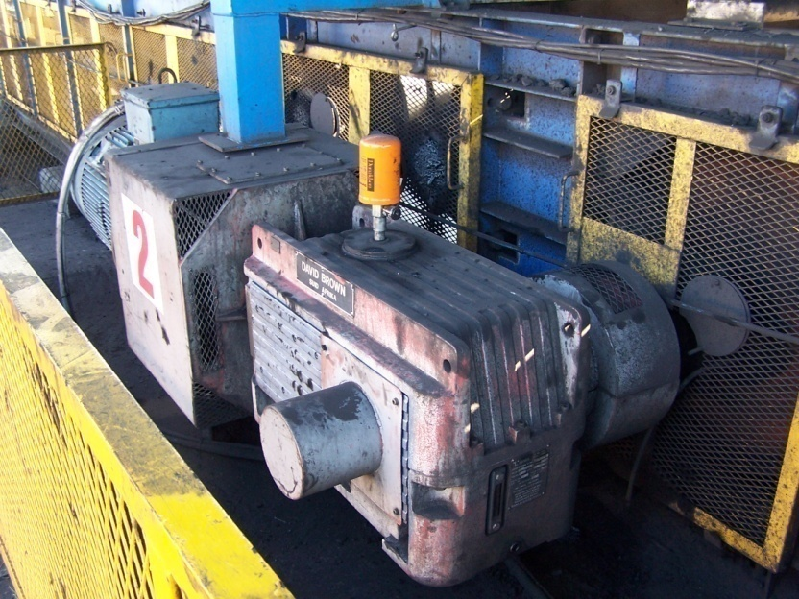
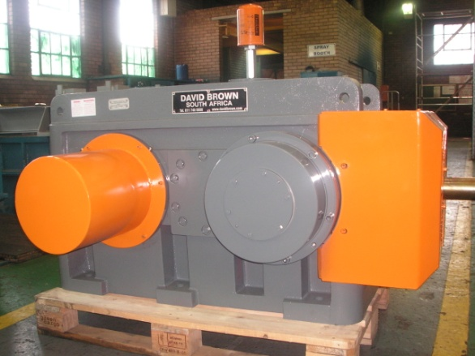
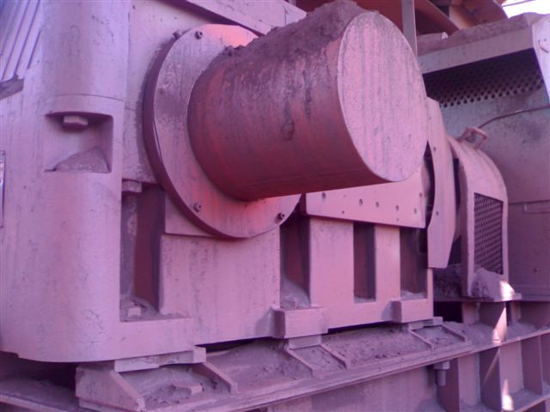
Conveyor Drives (100-1000kW)
A base plated shaft mounted conveyor unit power pack, with a David Brown South Africa Series L Gear unit.
A bell housing shaft mounted series L conveyor power pack.
A DB Series L gear unit,
Left- as manufactured,
Right- in operation under the harsh conditions of an iron ore mine.

Slide 9
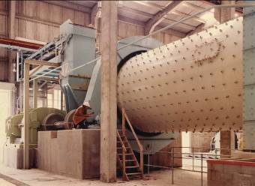
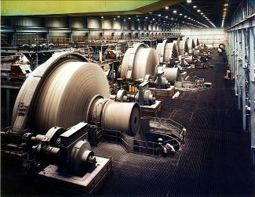
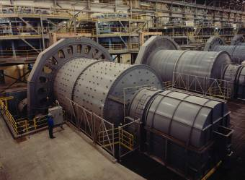
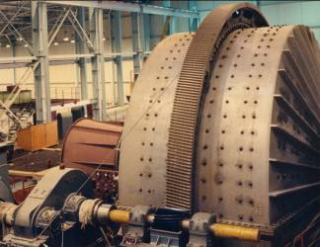
Raw Material Crushing & Grinding

Slide 10
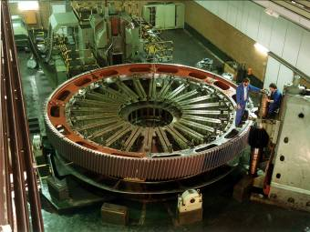
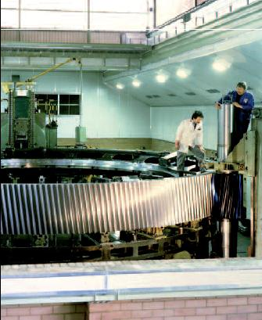
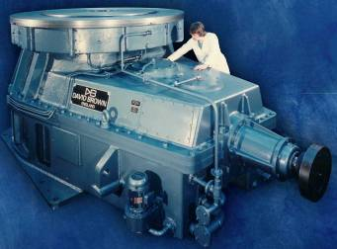
Raw Material Crushing & Grinding Products

Slide 11
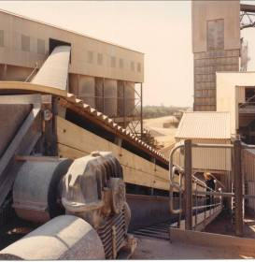
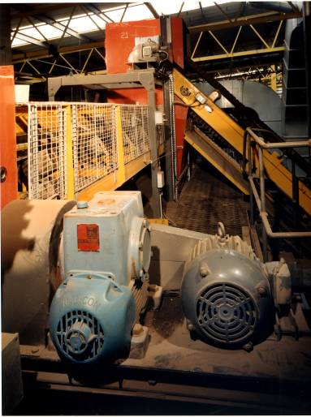
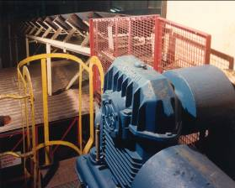
Materials Handling Products

Slide 12
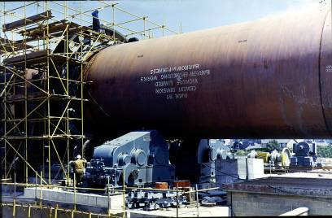
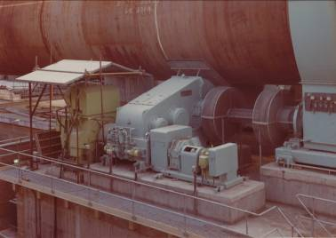
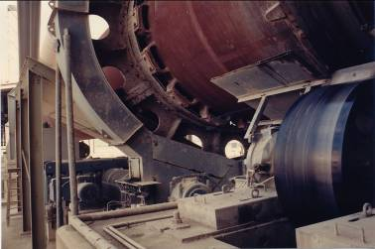
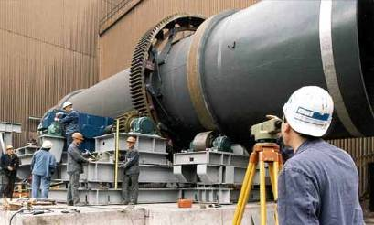
Kiln Drives for Cement Clinker Manufacture

Slide 13
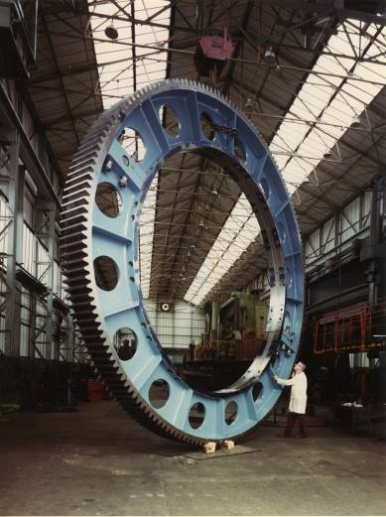
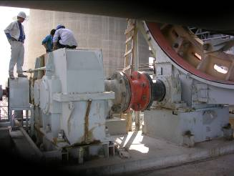
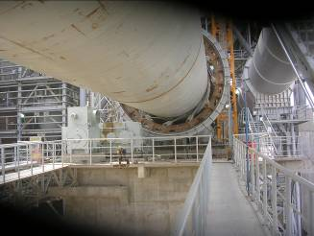
Kiln Drives for Cement Clinker Manufacture

Slide 14
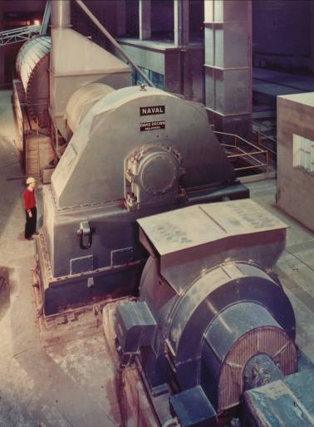
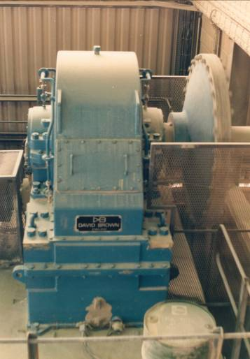
Cement Clinker Grinding

Slide 15
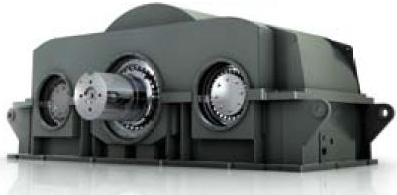
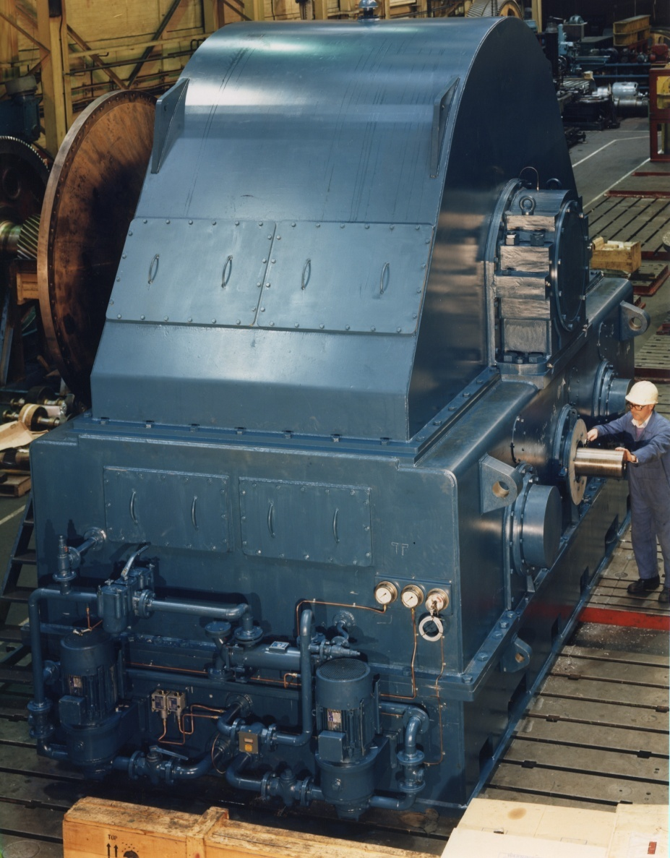
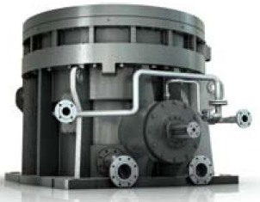
Cement Clinker Grinding Products

Slide 16
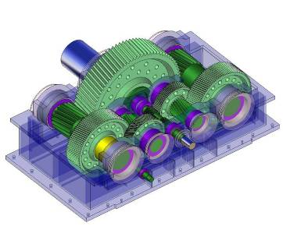
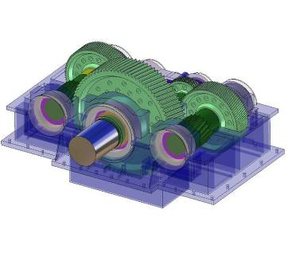
Case Study - Cement Mill Centre Drive
Specifications:
Input Power: 1 x 4,600 kW
Input Speed: 1,000 rpm
Output Speed: 15.00 rpm
Ratio: 65.873/1
Weight: 100,000 kgs
Specifications:
Rating Standard ISO 6336
SF (Wear): 2.50 min
SF (Strength): 3.00 min
Gear Life: 100,000 hrs
Bearing Life: 100,000 hrs
Designed and being supplied for Heracles General Cement (Lafarge Group), Volos Plant, Greece.

Slide 17
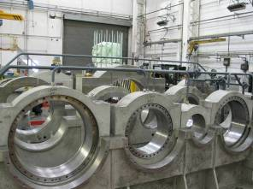
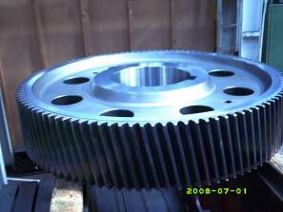
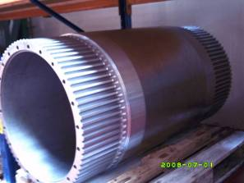
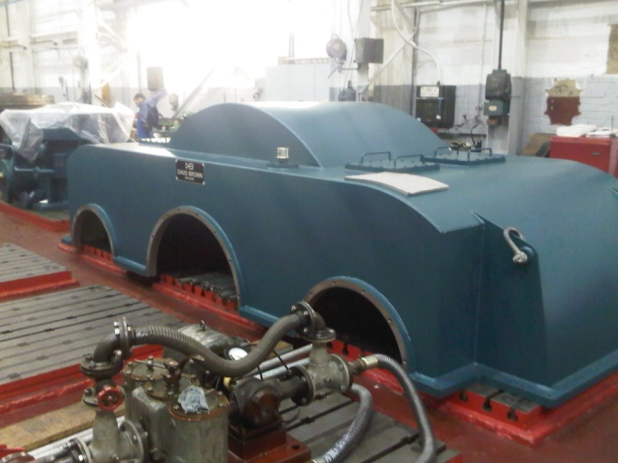
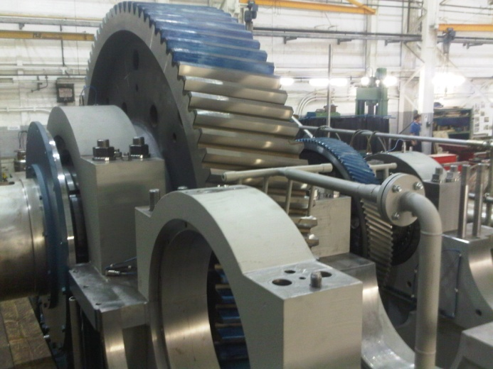
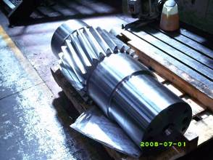
Case Study - Cement Mill Centre Drive

Slide 18
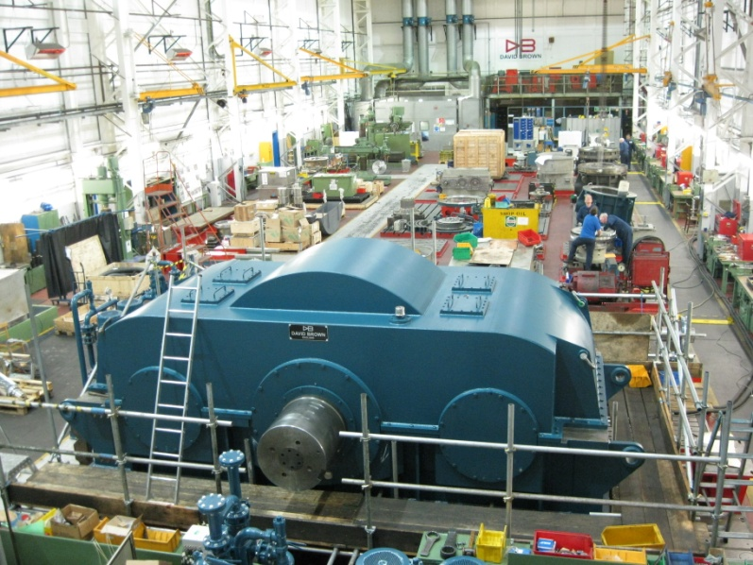
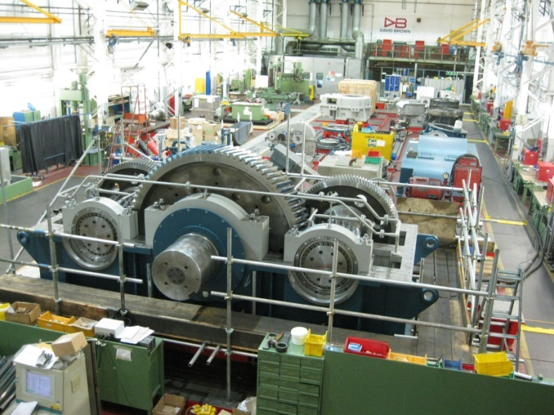
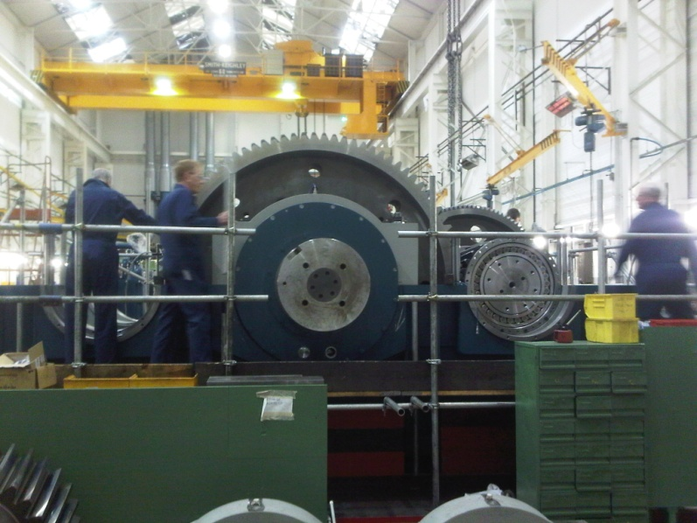
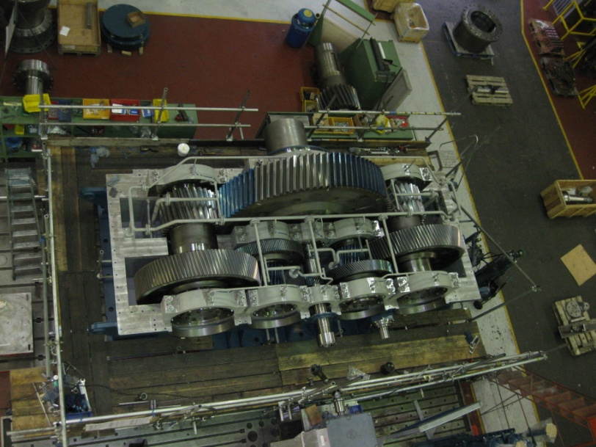
Case Study - Cement Mill Centre Drive

Slide 19

Titan Mill Centre Drives
David Brown offers a range of centre drive transmissions, optimised for use in cutting, shredding and milling applications
A range from 1,500kw to 10,000kW
Utilises a 2 Lay shaft ‘ Split Torque’ technology that enables load sharing and ‘half-load’ back up capability
David Brown design capability and extensive experience enable retrofit replacement of existing installations
Designed to simplify maintenance and inspection - horizontal split case design that enables easy top case removal and access to all drive shafts and bearings

Slide 20

General Design Principle
The “Split Torque” design of this unit is based on our proven Centre Drive unit which is specifically designed for sugar mill drives that are driven directly on to the mill head through a high torque coupling to the trunnion.
The top casing of the unit is not a structural member of the gear casing and can be removed without disturbing any of the internal components.
Design of the unit ensures torque is equally split between each line of reduction gears giving a balanced, reliable and smooth drive to the mill.

Slide 21





Our Centre Drive Pedigree…
Experienced with many installations globally that have provided trouble free operation for 50 years or more…..
DB “CD” Units
(Incl. “Symetro”)

Slide 22


Features of the Titan Range
Single piece, non structural top gear case designed to be removable in <1 hour for easy inspection and maintenance
Single piece forged, case hardened and profile ground main wheel, utilising naval marine expertise
Horizontal split gear case – enabling all gears to be inspected in-situ and removed/ repaired independently
LH and RH gear trains identical, minimising strategic spares holdings. Also enables unit to run at half load, should one gear train fail
No Overhung Gears – all gear shafts supported by bearings at each end
Optional auxiliary drive can be mounted to LH or RH of input shaft
All gears are case hardened and profile ground for maximum precision, quietness and reliability
Two lubrication pumps as standard – main pump and standby with automatic switching should one fail

Slide 23



The Benefits of Capability….
Benefits derived from industry leading manufacturing advances at David Brown:
Robust and reliable design:
  All gears are case hardened and ground using latest heat treatment and machining capabilities
  No overhung gears – all shafts supported with bearings at each end
Gear wheels manufactured from solid single forgings:
  ‘Leading edge’ heat treatment enables heat treatment of even the largest diameter gears (derived from naval marine technology)
  Now can offer single piece, forged main wheels for increased reliability/durability at the highest power requirements – many existing designs utilise 2 piece bolted rims as unable to heat treat at sizes required, leading to potential design weaknesses
Compact in size and footprint:
  Latest manufacturing technology enables increased power capability from the same physical footprint – more ‘power dense’ enabling mill power upgrades within same footprint

Slide 24


The Benefits of Experience: Easy Access
Benefits gained from design and applications experience:
Designed to enable quick access for inspections and routine maintenance:
  The horizontal split case design enables the top cover to be removed in <1 hour
  Quick and easy access to gears, bearings, spray bars etc
  Inspection can be conducted whilst in “Barring” mode with top cover off
Designed for simple maintenance and repair, reducing cost and time:
  Gearbox assembly enables individual shafts to be removable without disturbing others
  Gears and bearings mounted by oil injection method so that individual shafts can be simply stripped and overhauled if required
  Shaft assembly designed for quick bearing replacement

Slide 25


The Benefits of Experience: Maximised Uptime
Benefits gained from design and applications experience:
Designed for commonality of spare parts, reducing inventory:
  2 lay shaft ‘split torque’ design means that parts are interchangeable from left to right side – minimising strategic spares
Designed to ensure high availability:
  Two lubrication pumps as standard – main pump and standby with automatic switching should one fail
  Should the worst happen and a bearing or gear fails, the unit is able to continue running through the other unaffected gear train at half load until a planned repair can be completed
Inter-changeable parts for LH and RH drive trains

Slide 26

The Benefits of Experience: Optimised to your exact needs….
Benefits gained from design and applications experience:
Designed to be optimised and matched to exact needs:
  A range of models from 1,500kW to 10,000kW but each solution can be individually tailored to provide optimised design for specific customer needs e.g. the basic design enables flexibility of additional barring/auxiliary drive points
  Ideal for ‘drop-in’ retrofit of existing gearboxes, where upgraded performance is required with the same footprint and centre heights.
  Designs include a range of ‘tailored’ base plates to match existing foundation mounting points and mill centre height
Base Plates tailored to ‘drop-In’ to existing foundations and match existing centre heights

Slide 27
Technical Specifications
Minimum Design Specification for Gearing:
All gears manufactured from suitable single forged alloy steel (i.e. 17CrNiMo6 or equivalent), case carburised and profile ground to achieve a gear tooth surface hardness of 600BHN (58Rc)
Gear teeth single and double helical (Input Pinionshaft only) form and profile ground to AGMA Quality 12 (ISO 5)
All pinionshafts and wheel shafts simply supported with no cantilevered (overhung) gears or loads in any position throughout the gear unit
Each side of the split torque drive arrangement is designed to make use of identical components, thus minimising any spare parts stock holding
Gear wheels are positively keyed to their respective shafts in all cases apart from one, which is high pressure oil injection mounted when the gear unit and gears have been assembled and timed (torque split)

Slide 28

Technical Specifications
Gearcase:
Upper section, being non-structural, is of folded single wall design forming a cover/hood and being held together with the minimum number of bolted fixings to enable a quick release
Each gear casing undergoes detailed FEA (Finite Element Analysis) during the detailed design stage to further ensure integrity of each customer specific, optimised design
Lubrication System:
Gearboxes are supplied with separate lubrication systems, providing continuous streams of oil under pressure to the gear teeth, also feeding the bearings.
Twin Motor Driven Pumps (duty and standby)
Comprehensive control and protection system
System incorporates oil strainers and filters, with dual strainers to enable cleaning whilst in operation.
Water cooling with oil/water heat exchangers.

Slide 29




State of the Art Design and Detail
3D CAD design and detail enables David Brown to always work closely with the customer to optimise the detail design around specific customer needs

Slide 30


Applications References
Customer Vickers Ltd
Site APCM Northfleet , London.
Gearbox 24 x 38 x 56 Inch Centres TRG
Order No 180373 1968 4 Units (2LH 2RH)
Order No 180418 1968 8 Units (4LH 4RH)
Order No G180043 1971 2 Units (1LH 1RH)
Plus Girth Gears & Pinions
Pinion 27T
Girth Gear 270T
Mod 30
Facewidth 30 Inch
OD 328.88 Inch (8.354 Metres)

Slide 31

Applications References
Customer Polysius UK
Site Castle Cement Ketton
Gearbox CD 1900 centre drive
4600KW at 15.48rpm

Slide 32

Applications References
Customer Uniland Cementera
Site Barcelona
Gearbox CD1900
3300kw at 14.6rpm

Slide 33


Applications References
Customer Alexandria Portland Cement
Site Alexandria Egypt
Kiln drive
2521kw at 120rpm

Slide 34

Applications References
Customer Chengdu Lijun
Site Various
RPG Planetary Roller Press Drives
Range up to 2200kNm

